Slide 1
"Pricing Patterns: Using Regression Analysis to Forecast Airbnb Rates"
Presented By Harshitha Guthikonda, Qinwen Wang, Soumiya Chadha, and Weijia Su
05.02.24

Slide 2
Exploratory Data Analysis: Unpacking the Fundamentals
P A R T 0 1

Slide 3
P A R T 0 1
Work We Have Done
Further exploration of the dataset
Feature selection and training for predictive model
Experiment with different machine learning models
Visualization to enhance the interpretability of the predictive model
Hypothesis testing
Discussion about key insights, challenges faced, and potential areas for improvement
Notes:
This is the content for showing what we have done. Our team and I will share insights and details with the following slides to further introduce our methodology.

Slide 4
P A R T 0 1
Recap
Airbnb open dataset is a valuable resource containing information about hosts, precise locations, and essential metrics for making informed predictions and analyses. Our objective is to explore this data to predict prices that benefit both hosts and guests in making knowledgeable choices.
Recap from our last findings
48,895 entries
Variables: Location, Host, Room type
Visualization
Notes:
Our objective in Airbnb dataset is to explore this data to predict prices that benefit both hosts and guests in making knowledgeable choices.Through EDA, we gain a deep understanding of the features within the dataset, including their distributions, correlations, and interactions, which is essential for effective model building. By simply recapitulate our last workflow, we reduced dimensionality, detected null values and showed visulization.
Additionally, it guides the subsequent analysis steps by pinpointing the most relevant variables such as location, host, room types and so on.

Slide 5
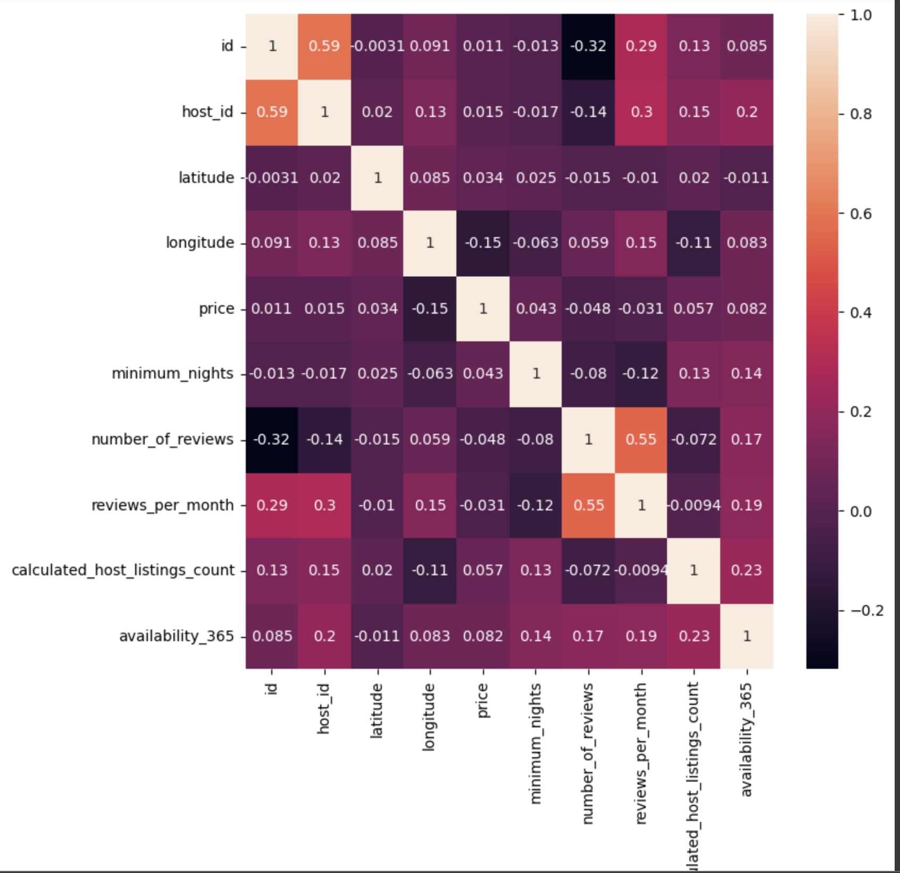
Each columns
1 as a positive relationship
-1 as a negative relationship
Correlation Matrix
Notes:
For correlation, 1 indicates a positive relationship and -1 indicates a negative relationship, the closer to 0, means no relationship of each variables. With a coefficient of 0.55 between reviews per month and number of reviews, there's a strong positive correlation, which is logical since more reviews could result in a higher average number of reviews per month.

Slide 6
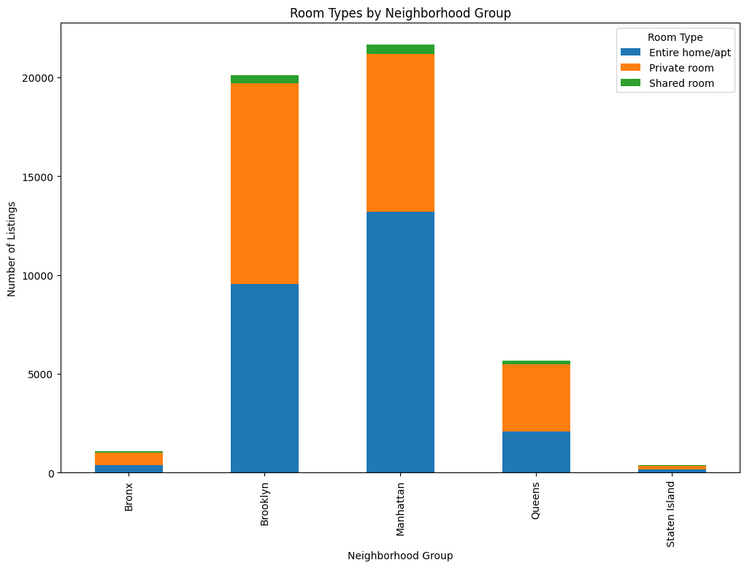
Visualizations from Last Findings
Geographical Insights:
Manhattan dominated by 'Entire home/apt' listings, which make up the largest proportion
Market Composition: Our analysis shed light on the diverse composition of the NYC Airbnb market, showcasing a blend of luxury and budget-friendly listings, composition across different burroughs and various room types
Notes:
Manhattan:
Dominated by 'Entire home/apt' listings, which make up the largest proportion indicating a market likely driven by tourism and higher rental prices.
Significant number of 'Private room' listings and Fewest 'Shared room' options
Brooklyn:
Substantial mix of both 'Entire home/apt' and 'Private room' listings. Brooklyn offers a balanced mix, suggesting a diverse market catering to different types of travelers.
Relatively more 'Shared room' listings than Manhattan, but still the smallest category.
Queens:
'Private room' listings are prominent, but 'Entire home/apt' options are also significant.
Bronx and Staten Island:
Fewer listings overall compared to Manhattan and Brooklyn.
'Shared rooms' are very scarce in these neighborhoods.

Slide 7
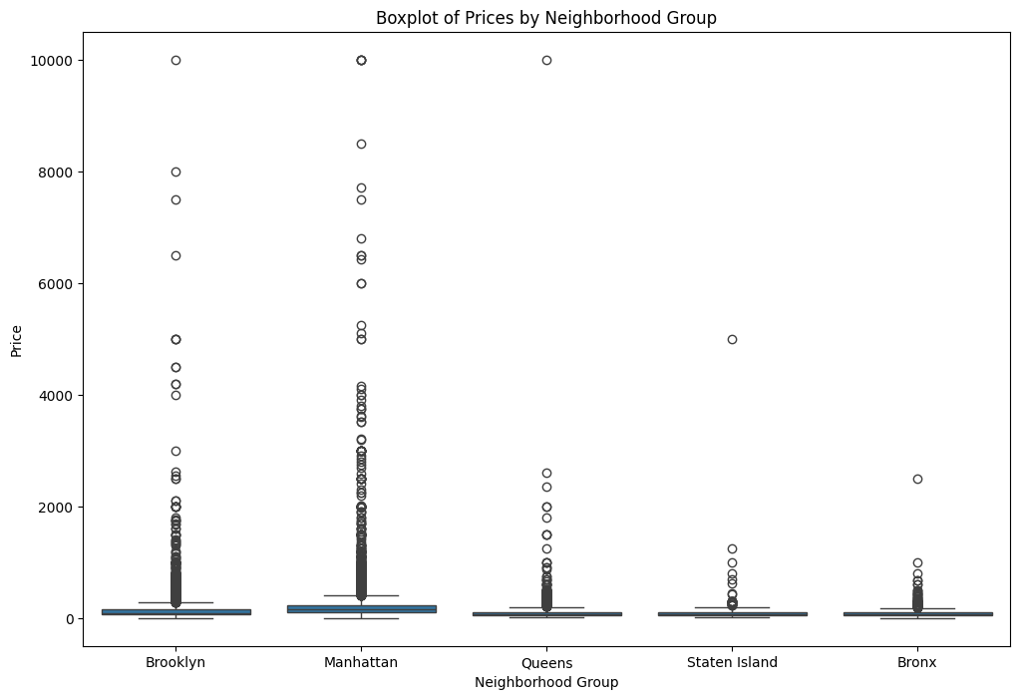
Investigated factors influencing listing prices, such as location, room type, and host reputation, to understand market dynamics and how they affect price. Here, is a boxplot of prices by neighbourhood group.
Notes:
Manhattan:
Shows the highest price points overall with many outliers, indicating a prevalence of luxury listings. The median price is higher compared to other neighborhoods, reflecting Manhattan's status as a prime location.
Brooklyn:
Exhibits a wide range of prices with several outliers, suggesting a variety in types of accommodations. The median price is lower than Manhattan, indicating more affordable options are available.
Queens:
Features a lower median price than Manhattan, implying greater affordability.
Fewer outliers, indicating a more uniform pricing structure than Manhattan or Brooklyn.
Staten Island and Bronx:
Both have the lowest median prices, suggesting these areas offer the most affordable options.
Very few outliers, indicating prices are generally consistent and lower.

Slide 8
Feature Engineering and Selection: Crafting the Predictive Framework
P A R T 0 2
Notes:
We are going to discuss the rationale behind features Engineering and Selection

Slide 9
Problem Statement
P A R T 0 2
The goal of this project is to predict the rental prices of Airbnb listings in New York City based on a set of geographical, property-specific, and host-related features.
Our model aims to provide stakeholders, including property owners, renters, and market analysts, with insights into the factors that significantly impact rental prices, enabling better decision-making regarding property investments, pricing strategies, and market positioning.
Notes:
With those features, we formulated the following problem statement.
The goal of this project is to predict the rental prices of Airbnb listings in New York City based on a set of geographical, property-specific, and host-related features.
The model aims to provide stakeholders, including property owners, renters, and market analysts, with insights into the factors that significantly impact rental prices, enabling better decision-making regarding property investments, pricing strategies, and market positioning.

Slide 10
P A R T 0 2
Feature Selection for Predictive Model
features = [
'neighbourhood_group',
'room_type',
'latitude',
'longitude',
'number_of_reviews',
'reviews_per_month',
'minimum_nights',
'availability_365'
]
target = 'price'
Each feature was selected based on its potential impact on rental pricing, as demonstrated by preliminary data analysis showing significant variations in price across different categories and locations.
These features are instrumental in developing a nuanced understanding of the dynamic Airbnb market, allowing for refined predictions that accommodate diverse consumer and host preferences.
Notes:
1. Feature Selection: "We selected features based on their potential impact on rental pricing, as shown by preliminary analysis. These include factors like neighborhood group, room type, geographic coordinates, number of reviews, reviews per month, minimum nights, and availability throughout the year."
2. Data Insights: "Our data showed significant variations in price across different categories and locations, which influenced our feature selection."
3. Model Development: "By incorporating these features, our predictive model can provide a nuanced understanding of Airbnb's dynamic market. This helps us make refined predictions that accommodate diverse consumer and host preferences."
4. Target Definition: "The target variable for our model is 'price', as our main objective is to predict rental prices accurately."
These notes summarize the rationale behind the feature selection and how it ties into the overall goal of your predictive model.

Slide 11
P A R T 0 2
Insights after Data Analysis
Geographical Pricing: Prices vary by location, indicating higher costs in certain popular areas
Market Composition: Most listings are entire homes/apartments, with price differences across neighborhoods.
Price Distribution: Many listings are affordably priced, with a concentration in the lower to mid-range.
Popularity and Demand: Listings with more reviews tend to be cheaper, suggesting higher turnover for budget options. The price-review correlation is weak.
Host Dynamics: A few hosts manage multiple listings, indicating professional or commercial hosts.
Regulatory Insights: Minimum stay requirements vary by area and room type, possibly due to regulations or host preferences.
Correlation Insights: Weak correlations between price, minimum nights, reviews, and availability show market complexity.
Review Analysis: Number of reviews serves as a proxy for popularity, with no strong link to price.
Availability Trends: Listings show varied yearly availability, suggesting strategic management by hosts.
Notes:
1. Geographical Pricing: "Prices differ significantly across areas, with higher costs in popular neighborhoods reflecting increased demand."
2. Market Composition: "Most of our listings are entire homes or apartments, showing varied pricing across different neighborhoods."
3. Price Distribution: "A large portion of our listings falls into the affordable category, primarily in the lower to mid-range price bracket."
4. Popularity and Demand: "More frequently reviewed listings tend to be priced lower, indicating they are budget-friendly and have higher turnover."
5. Host Dynamics: "A select group of hosts manage multiple listings, indicating a shift towards more professionalized hosting services."
6. Regulatory Insights: "Minimum stay requirements vary by location and type of room, often influenced by local regulations or host preferences."
7. Correlation Insights: "We observe weak correlations between pricing, minimum nights, number of reviews, and availability, which underscores the complexity of the market."
8. Review Analysis: "The number of reviews indicates listing popularity but does not necessarily correlate with pricing."
9. Availability Trend: "Listing availability varies throughout the year, suggesting hosts are strategically managing their properties."

Slide 12
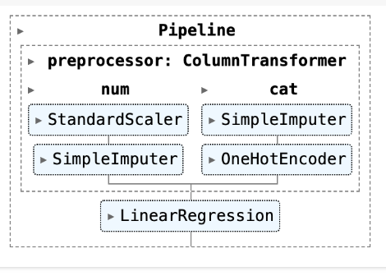
P A R T 0 2
Applied One Hot Encoding to categorical data like neighbourhood_group and room_type to transform categorical data into a format suitable for modeling.
Standardized numerical features like latitude and longitude using StandardScaler to normalize data distribution.
Used SimpleImputer to fill in missing values, ensuring data integrity.
Divided our dataset into two parts: 80% for training and 20% for testing. This split allows us to train our model on a substantial portion of the data while reserving a separate subset for unbiased evaluation
Fitted the Linear Regression model on the training set, which involves adjusting the model parameters to minimize the difference between the predicted and actual rental prices."
Utilized Root Mean Squared Error (RMSE) to quantify the model's prediction errors, resulting in an RMSE of 197.16.
An RMSE of 197.16 is competitive, considering the diversity of rental prices and the complexities involved in the real estate market.
Notes:
1. One Hot Encoding: "We transformed categorical data like neighborhood group and room type using One Hot Encoding to make it suitable for our model."
2. Data Normalization: "We standardized the latitude and longitude data using the StandardScaler to normalize the distribution, ensuring our model performs optimally."
3. Missing Values: "We used SimpleImputer to fill in any missing values in our dataset, maintaining data integrity."
4. Data Split: "We divided our dataset into 80% for training and 20% for testing, allowing us to train the model robustly while setting aside data for unbiased evaluation."
5. Model Training: "We applied a Linear Regression model to predict rental prices, adjusting model parameters to minimize prediction errors."
6. RMSE Utilization: "We used Root Mean Squared Error, or RMSE, to quantify the model's prediction errors, resulting in an RMSE of 197.16."
7. RMSE Context: "An RMSE of 197.16 is competitive, considering the diversity of rental prices and the complexities of the real estate market."

Slide 13
Model Development and Validation: Building and Testing the Predictive Model
P A R T 0 3

Slide 14
Predictive Model
Regression Equation:
Price = 92.630 -10.401*latitude + -24.091*longitude + -15.584*number_of_reviews + 4.633*reviews_per_month + -0.460*minimum_nights + 24.306*availability_365 + 31.366*x0_Bronx + 0.621*x0_Brooklyn + 60.009*x0_Manhattan + 28.406*x0_Queens + -120.401*x0_Staten Island + 82.002*x1_Entire home/apt + -22.307*x1_Private room + -59.695*x1_Shared room
These coefficients provide key insights into the geographic price variation across New York City (geographic features), which is critical for any stakeholder in the NYC Airbnb market.

Slide 15
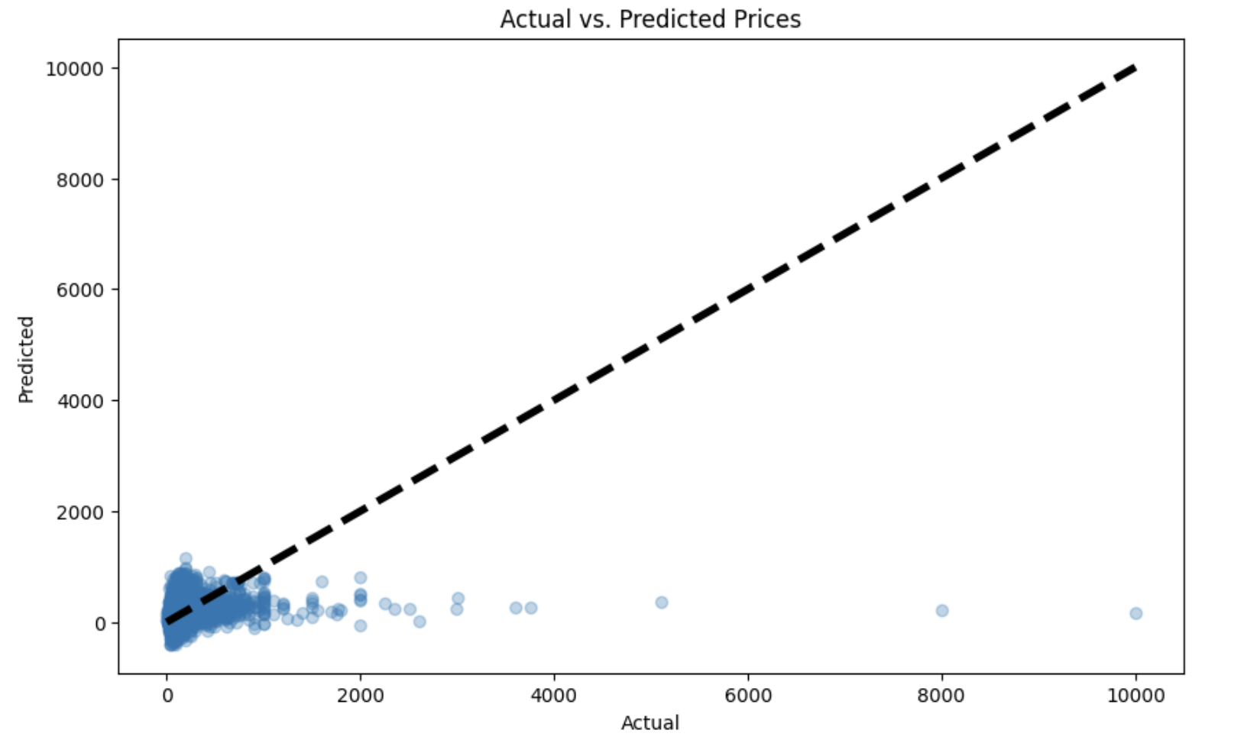
Linear Models: Linear Regression
RMSE: 222.935772
Concentration of lower prices
A tendency of the model to underpredict the higher prices
This model performs well for lower-priced properties.
Blue Dots: Predicted Prices
Dashed Black Line: Line of Perfect Prediction

Slide 16
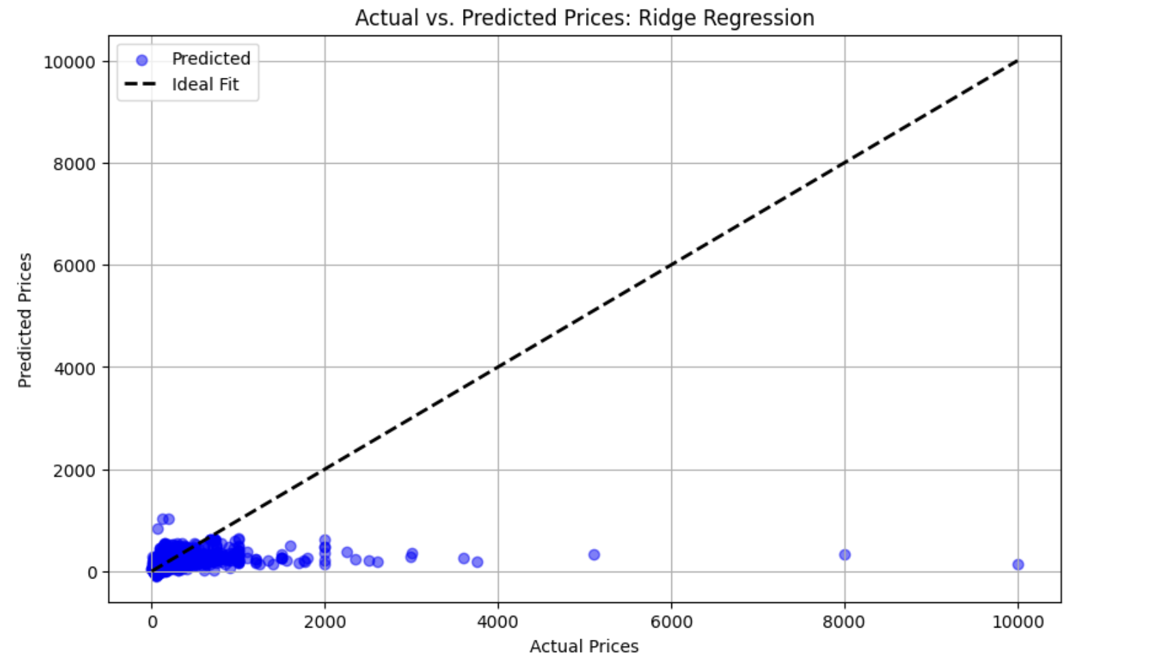
Linear Models: Ridge Regression
RMSE: 195.14552
Best RMS: 231.14535
The concentration of blue dots near the line at lower prices is fairly dense.
As prices rise, the model's predictions increasingly underestimate the actual higher prices.
This model seems to predict lower prices fairly well
Blue Dots: Predicted Prices
Dashed Black Line: Ideal Fit

Slide 17
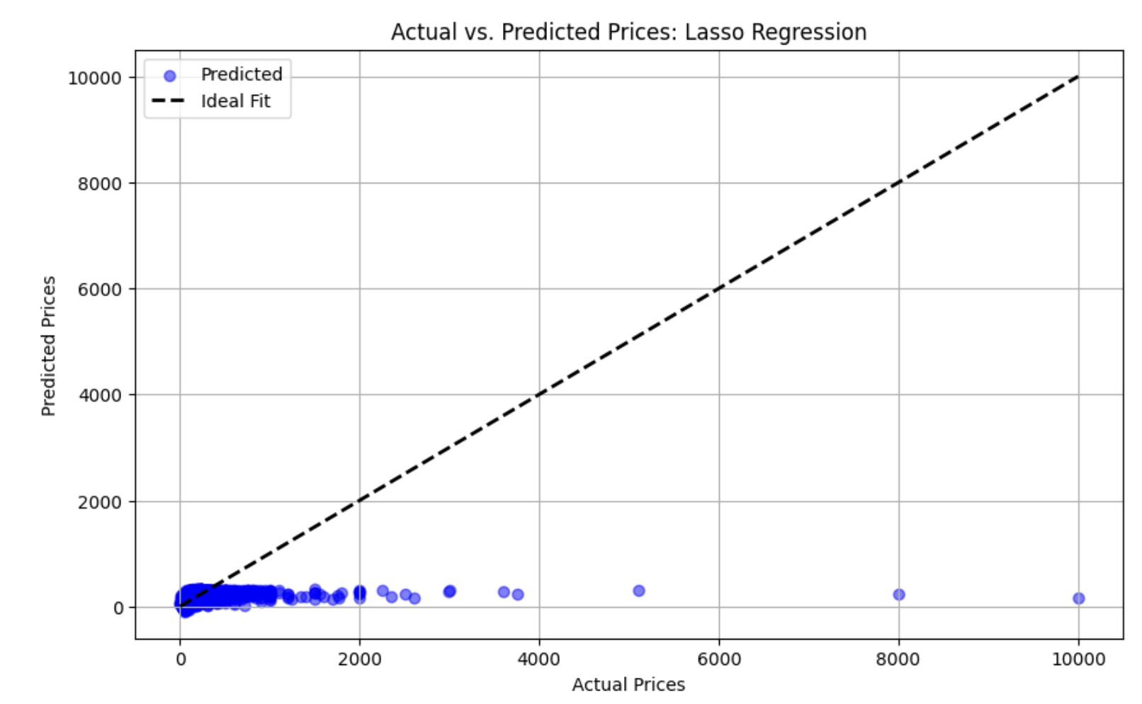
Linear Models: Lasso Regression
RMSE: 195.14552
Best RMS after Hypertuning: 235.27849
Most of the predicted prices cluster tightly around the lower actual prices, indicating that the Lasso model is quite accurate in this range.
The density of points near the lower price range suggests that the model has more data points and potentially better learning in this segment.
The spread increases with the price, indicating variability in the model's ability to accurately predict higher-priced listings.
Blue Dots: Predicted Prices
Dashed Black Line: Ideal Fit

Slide 18
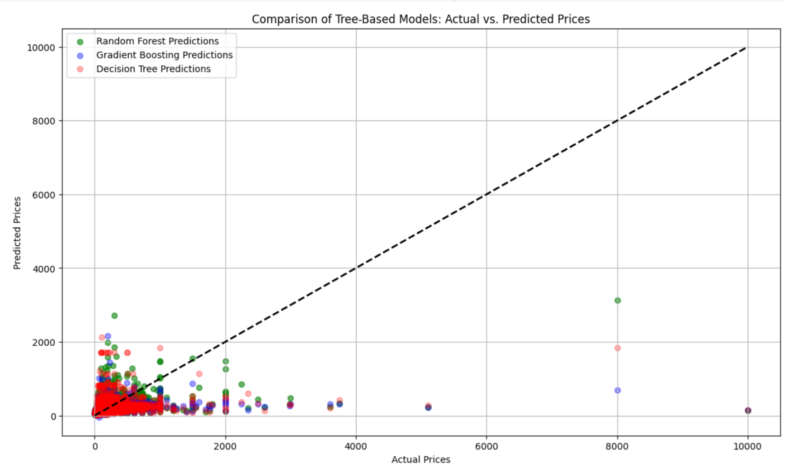
Tree Models:
Random Forest - RMSE: 190.578
Gradient Boosting - RMSE: 194.340
Improved Decision Tree - RMSE: 202.529
Random Forest predictions are clustered more closely to the ideal fit line, especially in the lower and middle price ranges, indicating good accuracy.
All models show a high density of predictions concentrated between the zero and $2000 price points.
Dashed Black Line: Ideal Fit

Slide 19
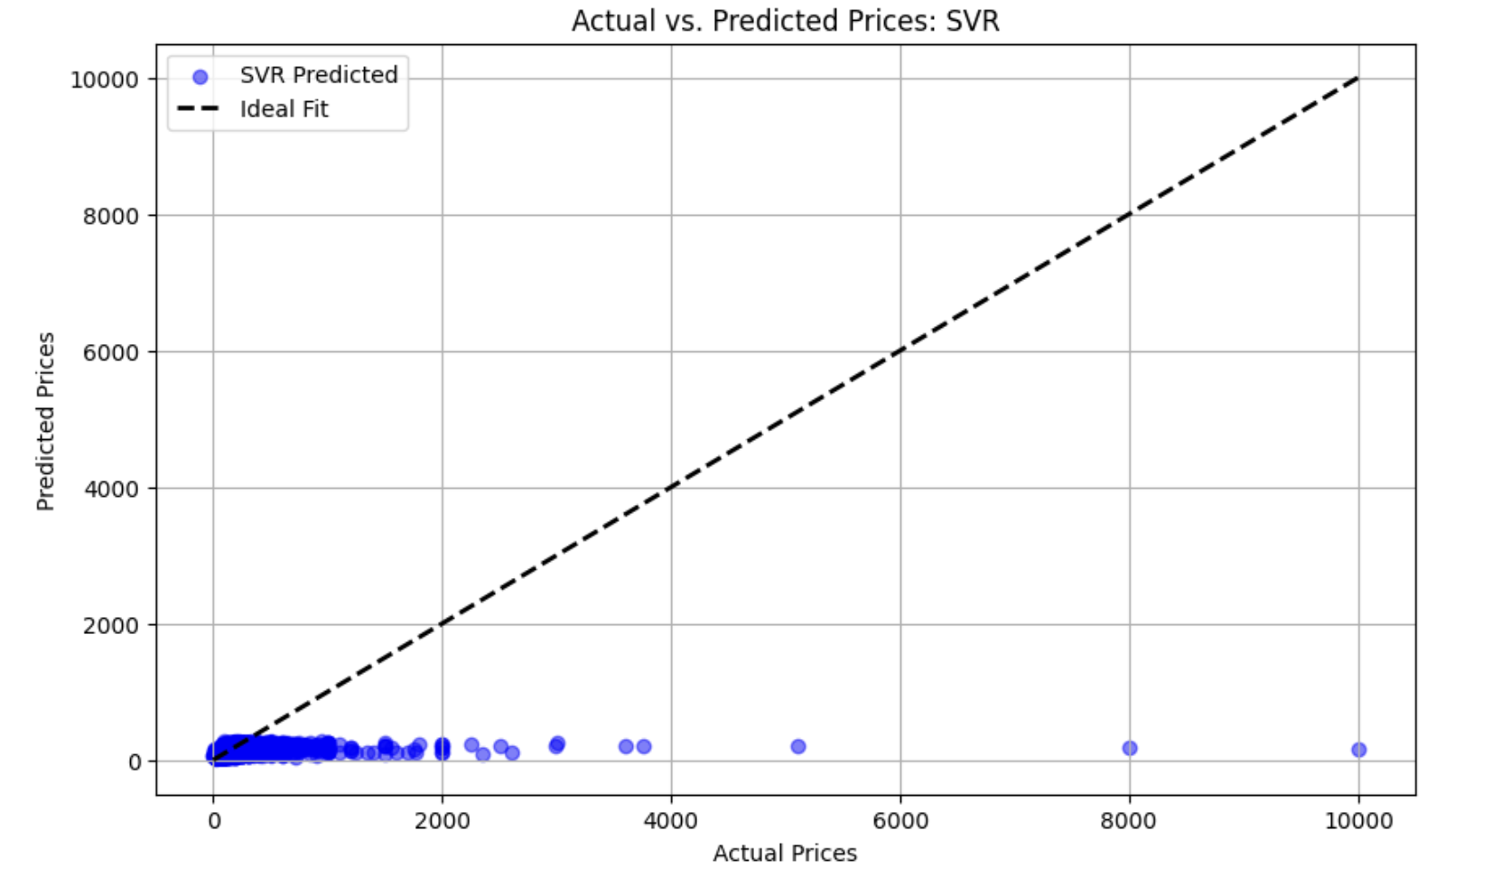
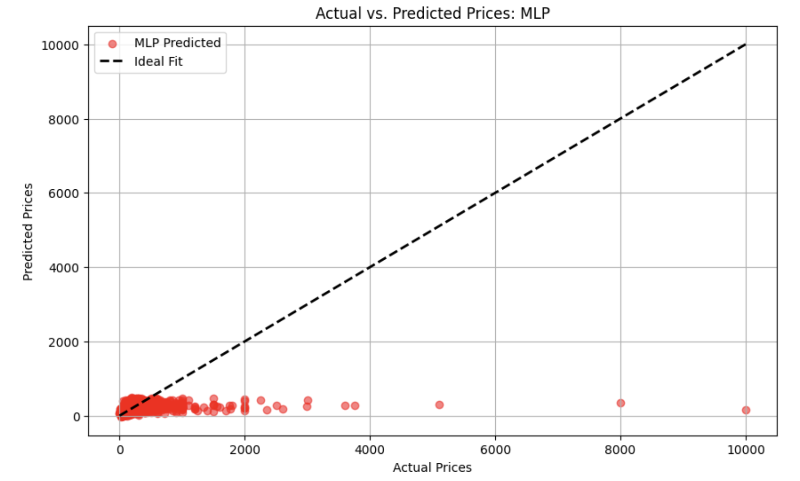
SVR vs. MLP
Both the SVR and MLP models effectively predict lower Airbnb prices but struggle with higher-priced listings.
Despite a broader range in MLP predictions, both models underperform at higher price points, indicating a need for model refinement and additional features.

Slide 20
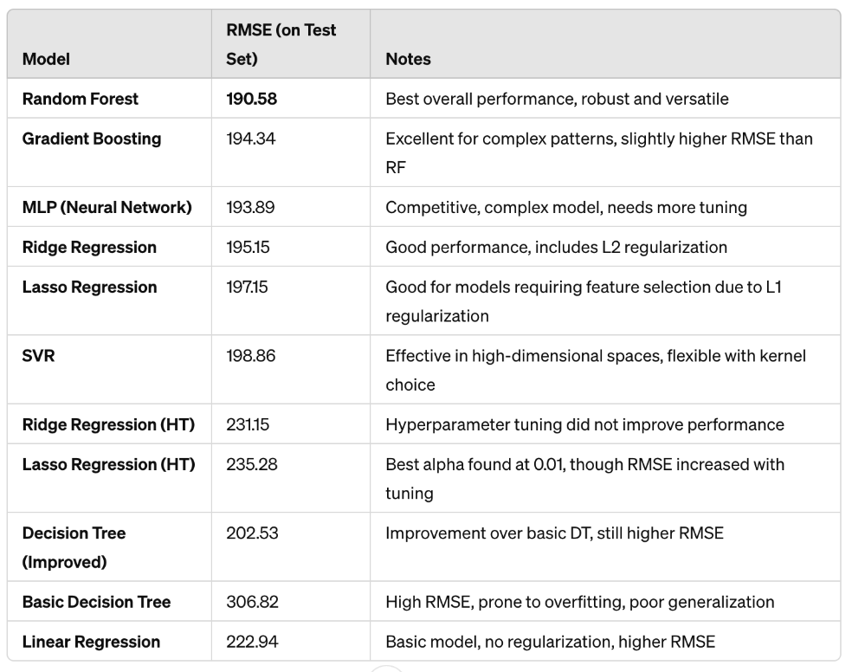

Slide 21
Insights and Implications: Interpreting Results and Strategic Recommendations
P A R T 0 4

Slide 22
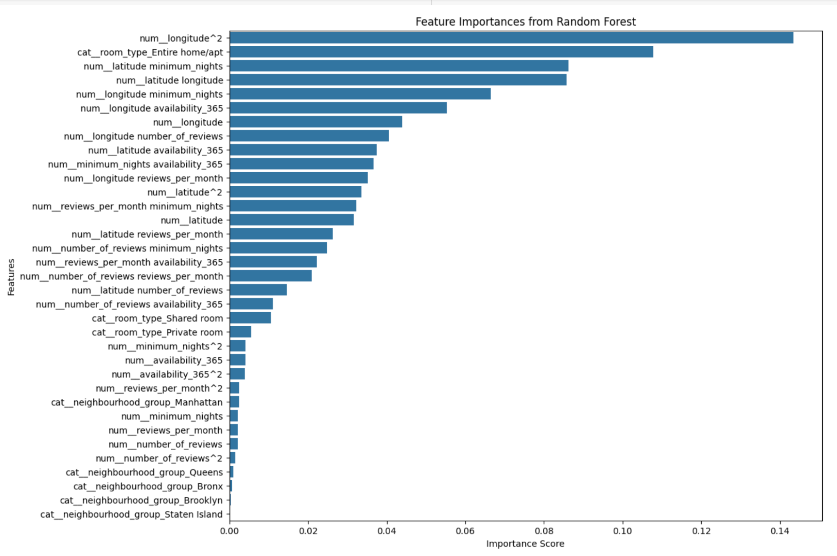
Key Insights
P A R T 0 4
1. Location is the Most Significant Factor in Pricing
The Random Forest feature importance graph illustrates that location is a key determinant of Airbnb pricing, with neighborhoods like Manhattan, Brooklyn, and Queens significantly impacting rates.
This underscores the importance of geographic location in pricing strategies and property investments in New York City's dynamic rental market.

Slide 23
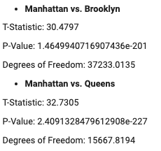
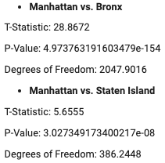
Hypothesis Testing
P A R T 0 4
ANOVA result:
1. Location is the Most Significant Factor in Pricing - Cont.
The results support the alternative hypothesis – “Listings in Manhattan are significantly more expensive than those in other boroughs”, suggesting that listings in Manhattan are significantly more expensive than those in other boroughs, supported by the high F-statistic and low p-values across all tests.
The analysis indicates that location (borough) has a significant impact on rental prices, with Manhattan being the most expensive borough.
T-tests for Manhattan vs. Other Boroughs:
Null Hypothesis (H0): There is no significant difference in the prices of listings between Manhattan and other boroughs.
Alternative Hypothesis (H1): Listings in Manhattan are significantly more expensive than those in other boroughs.

Slide 24
Key Insights
P A R T 0 4
2. Findings
Model Conclusion:
Hypothesis testing
Predictive performance
Challenges When Selecting and Building Models:
Overfitting or underfitting
Scalability and performance
Feature relevance and noise
Potential Areas for Improvement:
Improved data quality and expansion
Enhanced data segmentation
Continuous model refinement

Slide 25
Thank You

